Slide 1
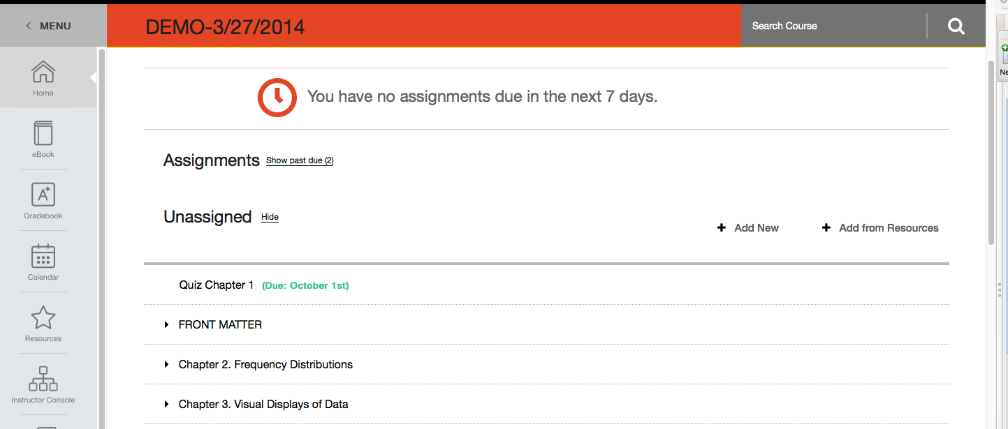
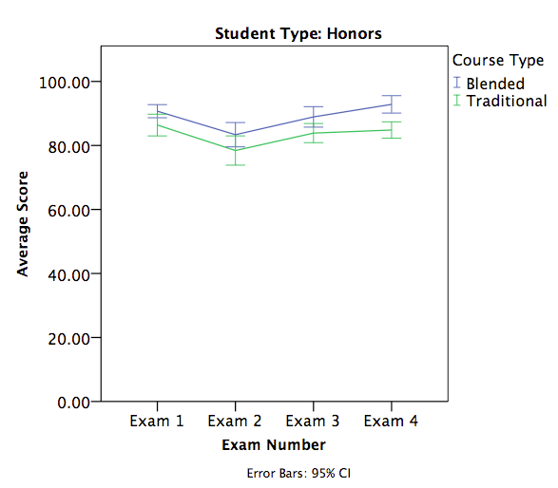
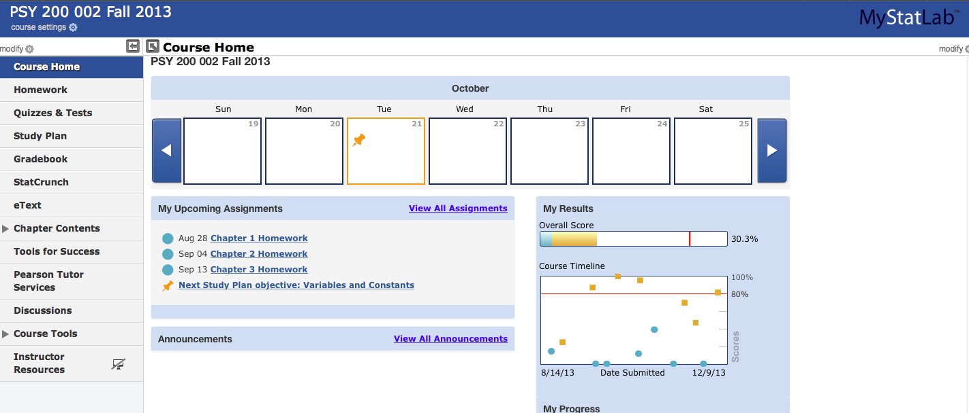
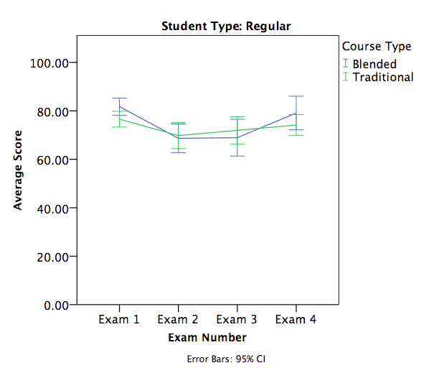
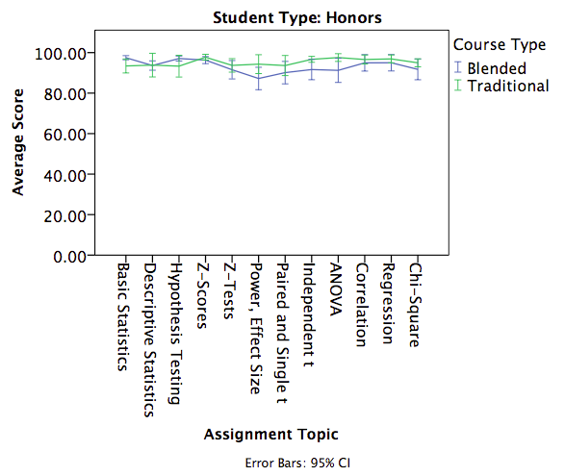
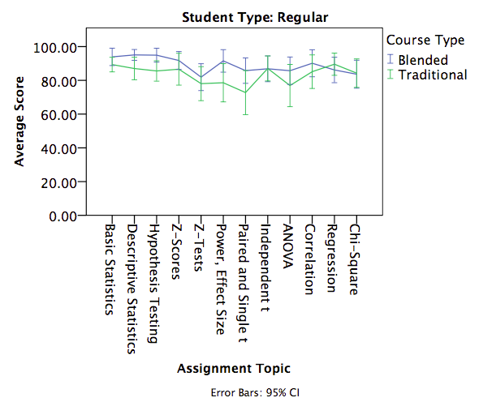
Shaking Up Statistics: A Blended Learning Perspective for Honors Courses
Erin M. Buchanan, Ph.D.
Missouri State University
Introduction
Why should we care about new methods of teaching statistics?
Retention of material is often poor (Lyle, 2011).
Today’s student may approach learning in new ways (Dziuban, Moskal, & Hartman, 2005).
What are the challenges to teaching a statistics class?
Students vary in their ability, motivation, and assertiveness (Perkins, 2001).
Since students have a low level of interest and lack preparation, students exhibit math anxiety (Wilson, 2013).
What are some techniques to solve possible problems?
Application exercises not only show the relevance of the subject but its repeated practice helps retention (Perkins, 2011).
Group work keep students actively engaged in the learning process (Wilson, 2013).
Blended learning is the combination of classroom face-to-face learning experiences with online learning experiences.
Advantages of Blended Learning
It satisfies social interactions while maintaining its flexibility (Cottle, 2011).
Disadvantages of Blended Learning
It is time consuming for the teachers to create and update courses and it increases student’s responsibilities (Cottle, 2011).
Blended Systems
Exam Grades
Blended sections showed an improvement in exam grades for honor students.
No differences in exam grades were found for regular students in blended and traditional sections.
Method
Homework Grades
Discussion
Instructors
All classes taught by a full time faculty member
Materials
Textbook:
Aron, Aron, and Coups (2012) Statistics for the Behavioral Sciences
Nolan and Heinzen (2014) Essentials of Statistics for the Behavioral Sciences
Blended component:
MyStatLab
StatsPortal
Assessments
Homework Assignments (12)
Exams (4)
Other assessments were given but not analyzed here.
Student N
Homework grades were roughly equal when blended and traditional classes were compared.
Students could repeat assignments up to three times for credit (with changing questions). Honor students used less attempts in a blended section than their traditional peers.
Pros
While homework grades appear roughly equal, blended learning translates to better exam grades for honor students, even with less practice attempts at homework assignments.
With the blended system, topics can be examined by specific learning objectives to target difficult concepts for future implementations.
Somewhat automated grading, instant feedback, ability to generate multiple practice trials for students.
Positive student reaction to online components, especially integration with Blackboard.
Cons
Systems vary in their user design and interface capabilities.
Technology growing pains for students/developers.
Large learning curve and design implementation time for the instructor.
Statistics is a difficult course to “flip” into a truly blended design.
Limitations
Two different books/systems of blended learning.
Instructor experience gained with teaching experience in blended systems.
Future Directions
Examine specific learning outcomes to determine if blending is more effective for technology or theory based components.
Homework grades were more varied for regular students but slightly higher in the blended section.
Regular students used more attempts and took longer to answer those attempts than their peers.
Semester | Honors | Regular | Course Type
Spring 12 | 13 | 10 | Traditional
Fall 12 | 24 | 24 | Traditional
Spring 13 | 4 | 16 | Blended
Fall 13 | 23 | 26 | Blended
Spring 14 | 25 | 0 | Blended
Contact
Erin M. Buchanan (erinbuchanan@missouristate.edu)

